Slide 1
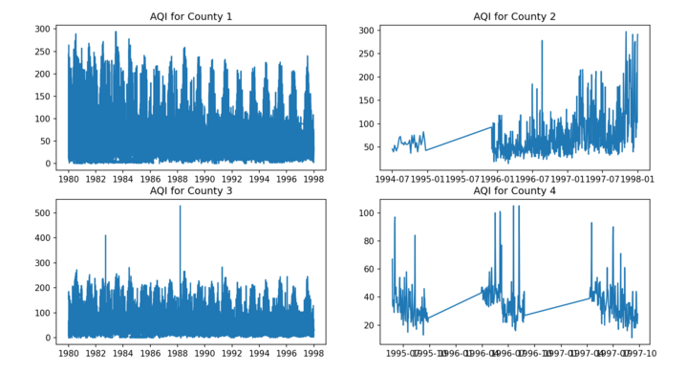
CUSUM- Initial Issues
Seasonal increases makes pinpointing outliers more difficult
Need to consider how to best to set parameters to find correct outliers
Currently: expected value= mean AQI value by county while the slack variable and threshold are set using standard deviations

Slide 2
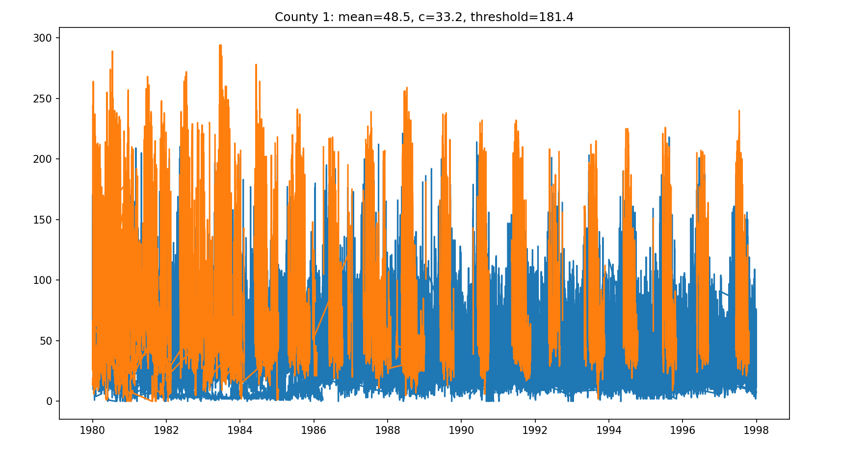
Slack variable = 1*std, Threshold = mean + 4 * std

Slide 3
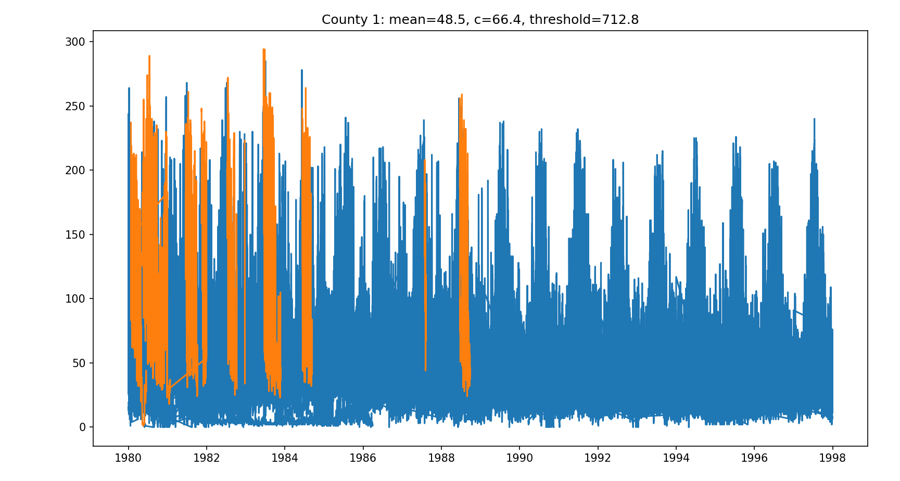
Slack variable = 2*std, Threshold = mean + 10 * std

Slide 5
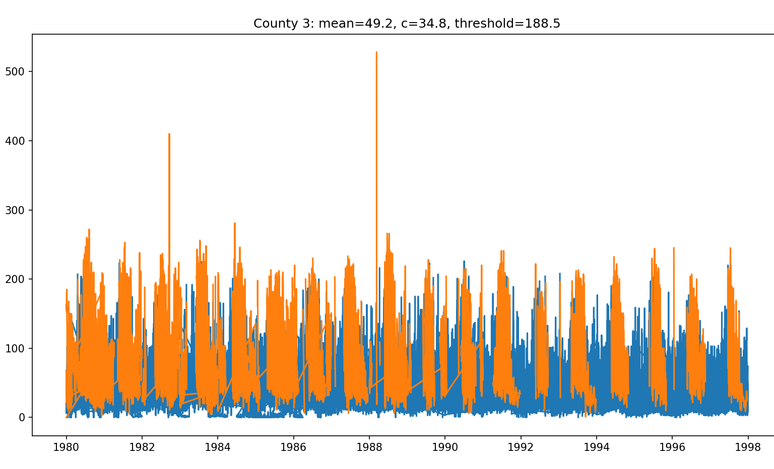
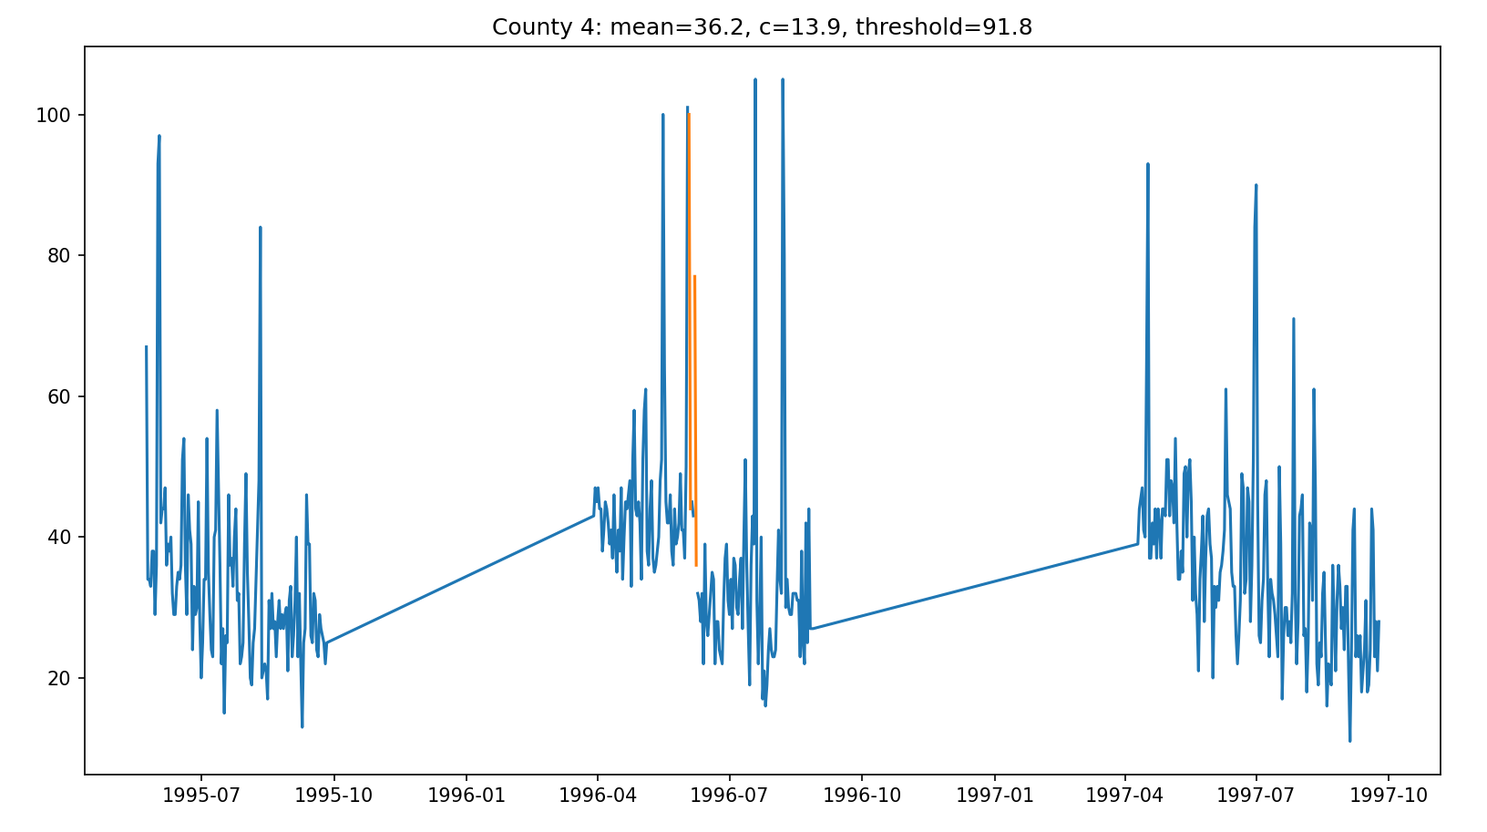
Slack variable = 1*std, Threshold = mean + 4 * std
Compared to county 1, counties 3 and 4 have more clear outliers,
But the same formula to set the parameters (see title) results in too many identified in county 3 and too few identified in county 4

Slide 6
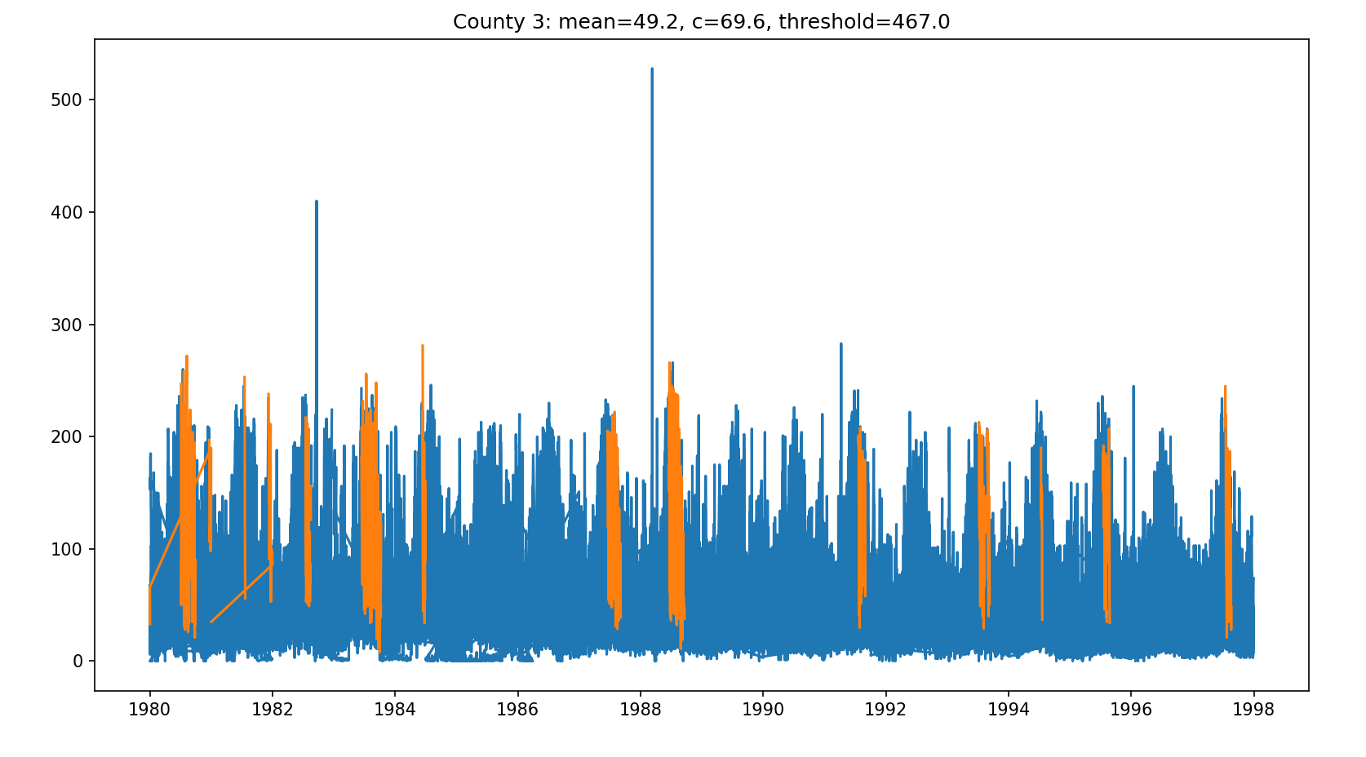
Slack variable = 2*std, Threshold = mean + 6 * std
Here is an example where CUSUM doesn’t identify the outliers we would expect it too

Slide 7
DBSCAN
More promising initially than CUSUM
2 key parameters: eps (radius of neighborhood) and minPts (min # points to form cluster)
Currently,hardcoded both to 0.01 and 3 and the result was reasonable for all 4 test counties
For actual implementation, would need a better approach to choosing them.
Finds high and low outliers
Doesn’t account for seasonality but we could potentially incorporate this by adding factor variables, e.g., for month, day of week, time of day, etc.
In the 4 example plots on slides 7-10, outliers = big black circles

Slide 8
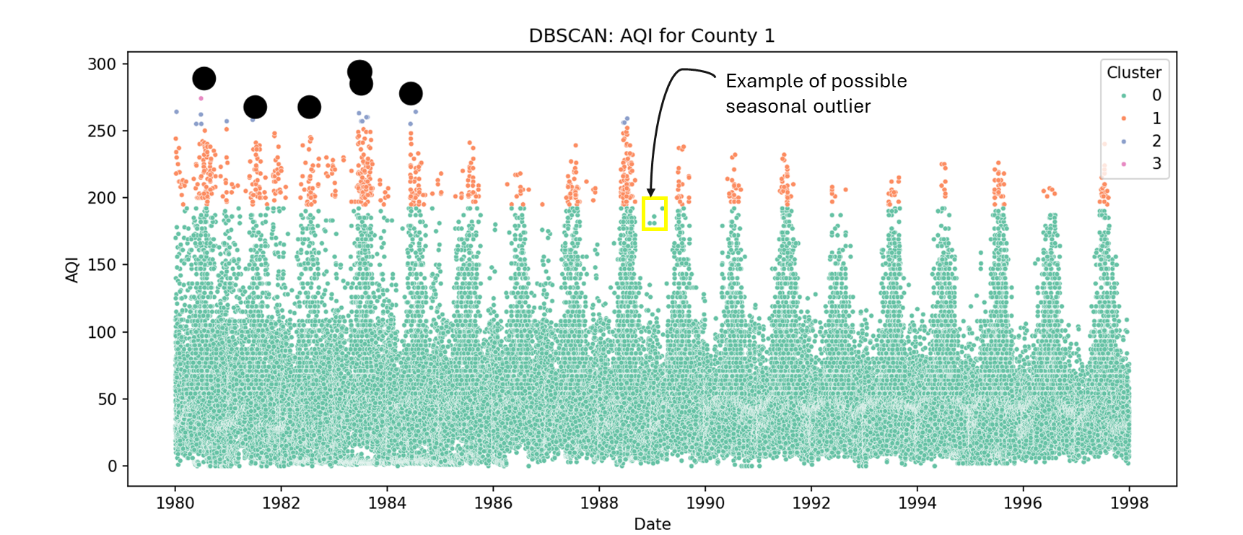

Slide 9
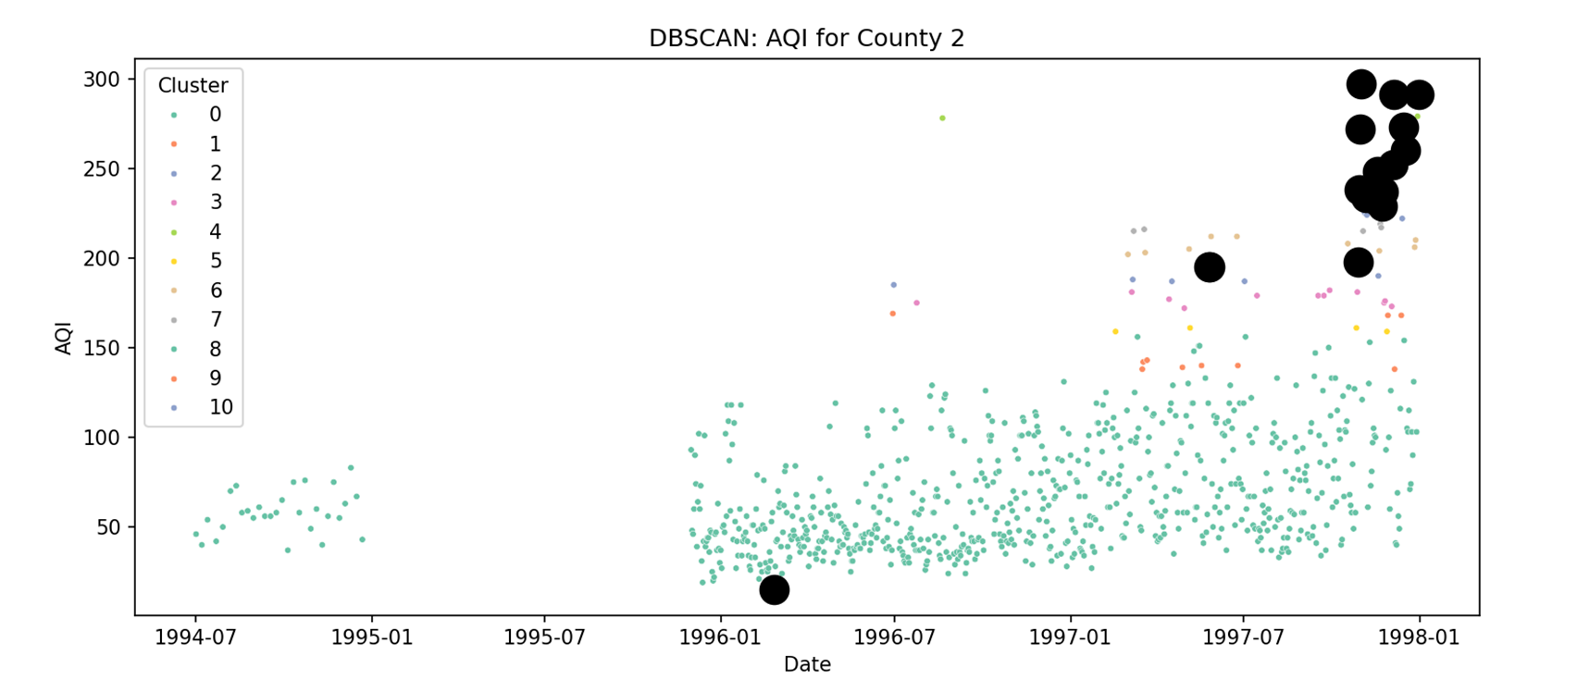

Slide 10
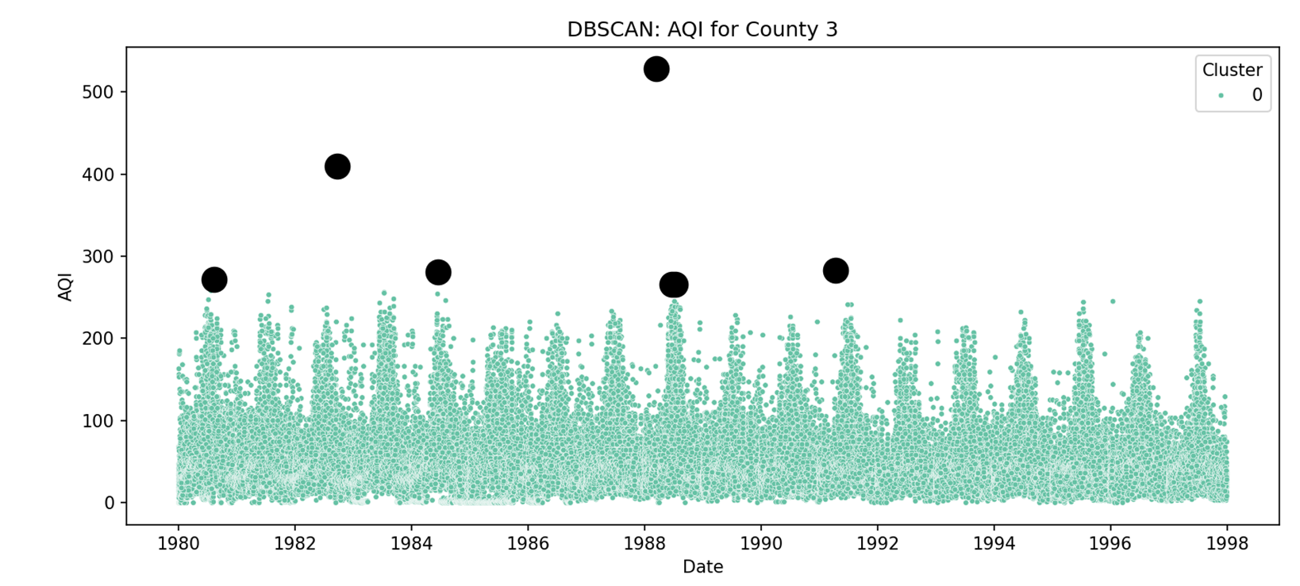

Slide 11
